Slide 1
Topic Modelling Bookmarker
CS 510 Advanced Information Retrieval
Lahari Anne, Sanjay Raj Aerra, Sasi Pavan Surapaneni

Slide 2
Motivation
In the digital age, individuals encounter vast amounts of data daily, especially during online research and browsing. Managing and organizing this data efficiently remains a significant challenge, leading to time wastage and reduced productivity.
Traditional bookmarking involves manually saving and categorizing web pages, which is time-consuming and often leads to clutter. Studies and surveys indicate that users find it difficult to retrieve information from poorly organized bookmarks, affecting their workflow and satisfaction.
Automating the process of categorizing bookmarks through advanced NLP and ML techniques can significantly streamline information retrieval. By providing users with smart suggestions for topics and sentiment analysis, the extension can enhance the overall browsing and research experience.

Slide 3
Approach
Problem:
A tool that not only saves URLs but also analyzes, categorizes, and suggests topics based on the content of the web pages. The functionality would transform bookmark management into a more dynamic and user-friendly process.
Approach:
Employing Natural Language Processing (NLP) to analyze the text content of web pages. Automatically generate topics using algorithms like Latent Dirichlet Allocation (LDA), enabling smart categorization of bookmarks based on their content.
Implementing sentiment analysis to gauge the overall sentiment of the content (positive, neutral, negative).Helps users understand the tone of the content before revisiting the bookmarked page, useful in research and content filtering.
Choosing Google Chrome as the development platform due to its widespread use and support for robust extensions.
Tools Used:
JavaScript: For extension development and client-side scripting.
Python: For backend processing, especially for NLP and machine learning components.
NLTK/SpaCy/Gensim: For processing language and performing NLP tasks.
Google Chrome Developer Tools: For testing and debugging the Chrome extension.

Slide 4
Latent Dirichlet Allocation (LDA) in Topic Modelling
Training the LDA model:
Compiled a comprehensive corpus from diverse sources like news articles, academic papers, and web content, ensuring varied topic representation.
Utilized NLTK for natural language tasks such as tokenization, stopword removal, and lemmatization to refine the text data.
Created a dictionary mapping of words to unique IDs and converted the preprocessed text data into a bag-of-words corpus using Gensim
LDA Model Configuration:
Gensim’s LdaModel: Chosen for its robustness and ease of use in training LDA models. It facilitates the learning of topic-word distributions effectively.
Parameter Settings: Configured the model with an optimal number of topics, update intervals, and chunk sizes to improve convergence and topic quality.
Training Execution: The model was iteratively trained on the corpus until the topics were stable and coherent, using perplexity and coherence scores as metrics to monitor performance.
Using the LDA Model:
Topic Inference: Post-training, the model was used to infer the topic distribution of new documents, enabling dynamic topic suggestion when users bookmark new web pages.
Topic Assignment: Each bookmarked page was analyzed in real-time, assigning the most relevant topics based on the LDA model’s topic-word probabilities.

Slide 5
Enhancing Content Understanding with Sentiment Analysis
Implementation Details:
Tool Used: Utilized the VADER (Valence Aware Dictionary and sEntiment Reasoner) tool, renowned for its effectiveness in handling social media texts and general sentiment analysis.
Integration: Incorporated within the Google Chrome extension to analyze content in real-time as users navigate and bookmark pages.
Process of Sentiment Analysis:
Data Handling: The content of each web page is extracted and processed the moment a user decides to bookmark the page.
Analysis Execution: The SentimentIntensityAnalyzer() class from the NLTK library is employed to perform sentiment intensity analysis on the text, assigning scores based on predefined sentiment lexicons.
Score Computation: The analyzer computes scores across four categories—positive, negative, neutral, and compound. The compound score is an aggregated measure that indicates the overall sentiment.
Benefits of Sentiment Analysis in Bookmarking:
Enhanced Content Filtering: Allows users to filter and sort their bookmarks based on sentiment, potentially segmenting content into inspirational, informational, or cautionary.
Improved User Experience: By understanding the sentiment of the content, users can manage their bookmarks more effectively, aligning content categorization with their preferences and emotional responses.

Slide 6
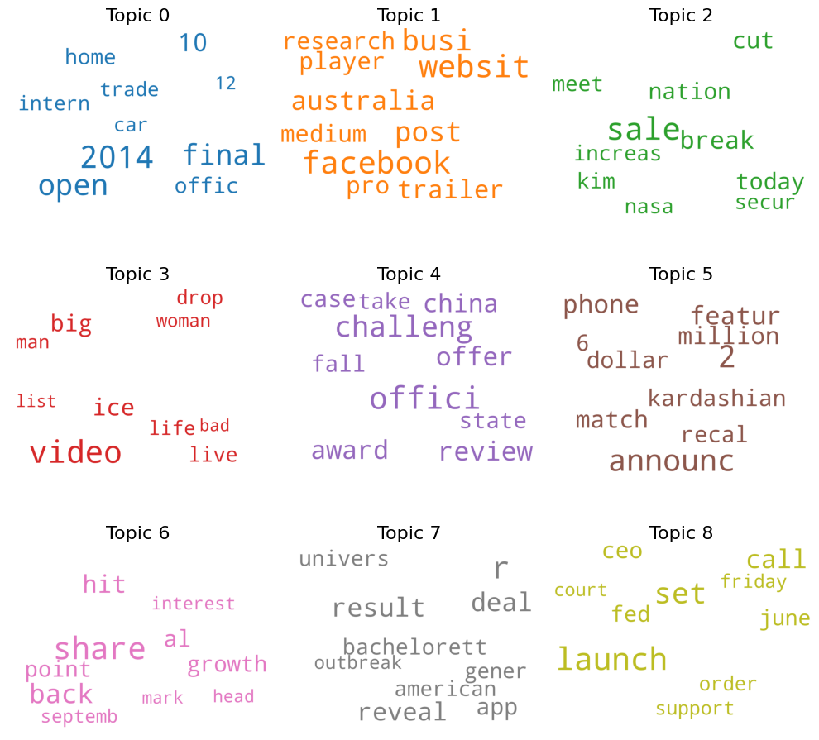
Topic Clustering
This plot shows the topic could generated by the LDA model. We trained the model with parameters to obtain 20 topics with each topic containing 10 words.
We then clustered these 20 topics into 3 main categories namely “Business and Politics”, “Entertainment & Lifestyle”, and “Technology and Science”. This clustering is based on the words in the topic and the type of corpus we used. Extending the corpus further can help in diversifying the topic modelling process.

Slide 7
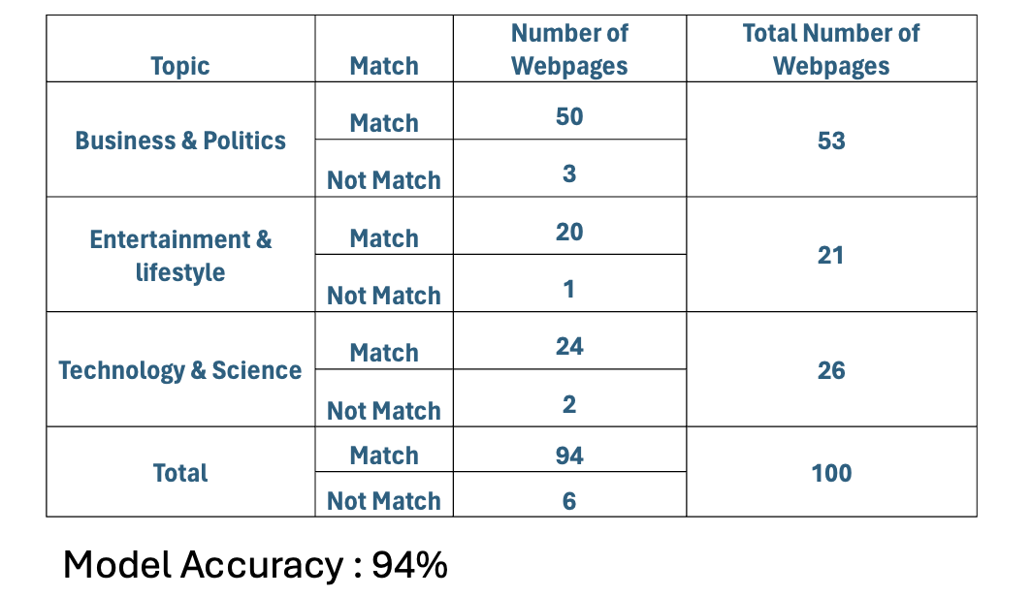
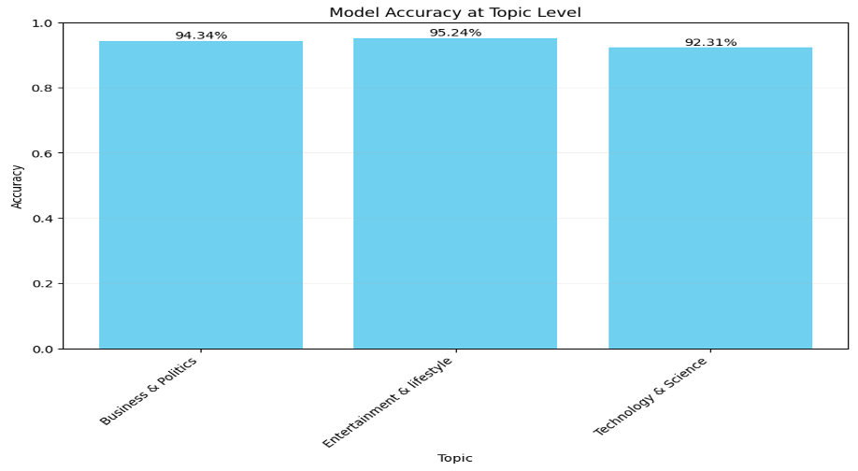
Results
Model Accuracy:
The model achieved a high overall accuracy in correctly categorizing web pages based on their content. 94% overall accuracy across all tested web pages.
Business & Politics: 94.34% accuracy. Out of 53 web pages, 50 were correctly matched to the topic.
Entertainment & Lifestyle: 95.24% accuracy. Out of 21 web pages, 20 were correctly matched.
Technology & Science: 92.31% accuracy. Out of 26 web pages, 24 were correctly matched.
High accuracy rates indicate robust topic modeling capabilities, particularly in differentiating content types effectively.
Areas for Improvement: Minor mismatches suggest potential refinement in model training or adjustment in topic definitions might further enhance accuracy.

Slide 8
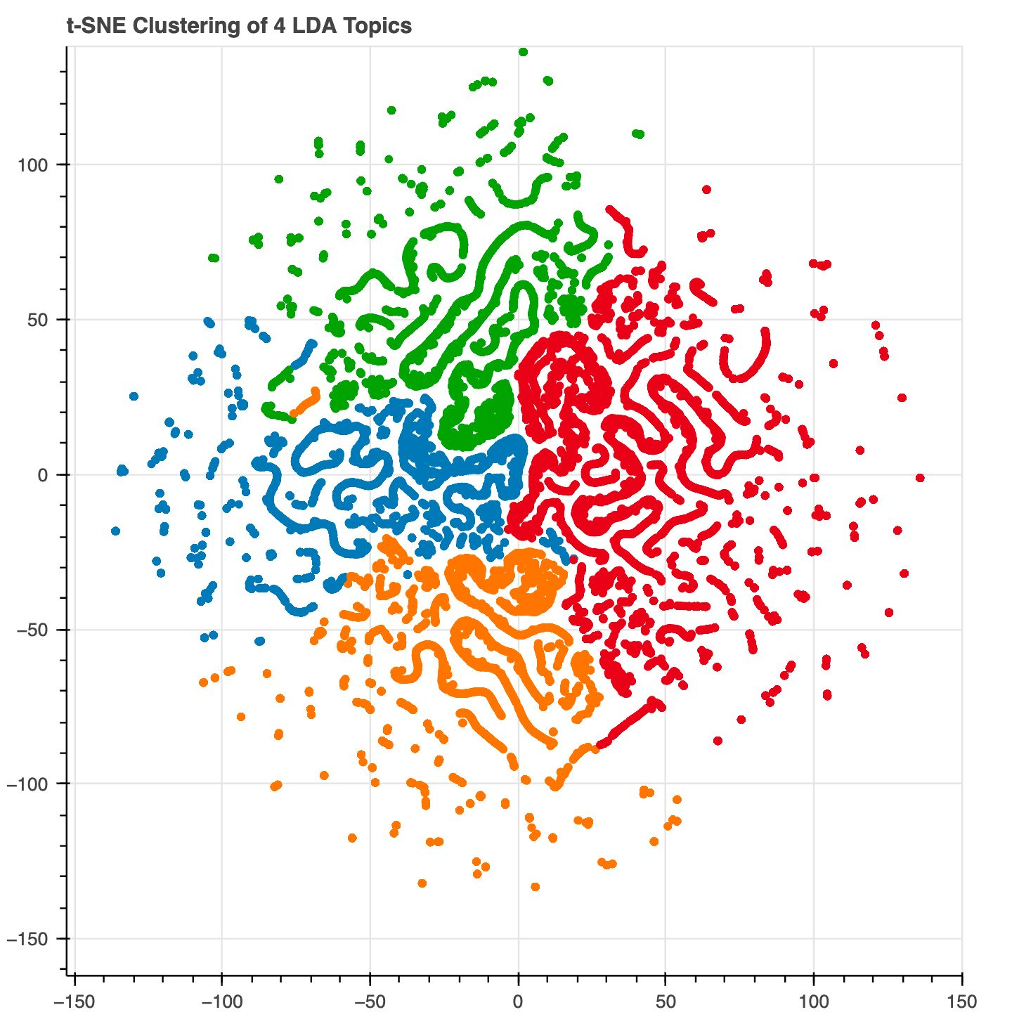
Results(Visualization)
Introduction to t-SNE:
t-Distributed Stochastic Neighbor Embedding (t-SNE) is a machine learning algorithm for dimensionality reduction that is particularly well suited for the visualization of high-dimensional datasets
Insights from t-SNE Clustering:
Each color cluster represents documents that are closely related in terms of thematic content. Clear boundaries between clusters suggest good model separation ability.
The clear segregation of most topics indicates effective learning and representation by the LDA model.
Overlapping regions could be explored further to refine topic definitions or adjust model parameters for clearer distinctions.
This t-SNE visualization assists in understanding how well the LDA model has performed in segregating different thematic contents into discernible and coherent topics.

Slide 9
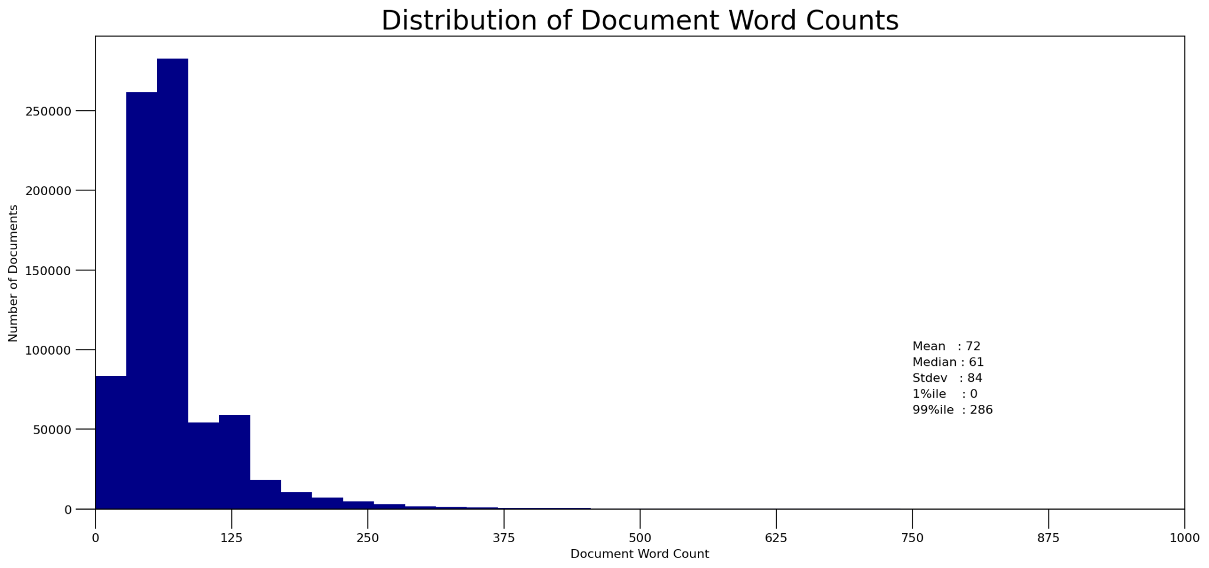
Result (Visualization)
This plot shows the distribution of document word counts across the 800 thousand documents we used in our corpus. This corpus, as discussed earlier is consolidated from 5 varied datasets.

Slide 10
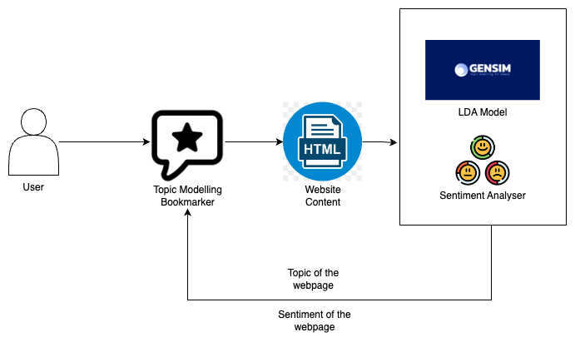
Flow diagram of the tool
A user bookmarks a webpage using the Topic Modelling Bookmarker.
The bookmarked website content is then processed to extract its main topic using the Gensim-powered LDA model.
Simultaneously, the content undergoes sentiment analysis to determine its emotional tone.
The results, including the topic and sentiment of the webpage, are displayed back to the user for enhanced understanding and categorization of their bookmarks.

Slide 11
DEMO

Slide 12
Contributions
Lahari Anne: Frontend development of the Chrome extension, user interface design, and topic modeling implementation.
Sanjay Raj Aerra: Backend development, implementation of sentiment analysis algorithms, and backend server setup.
Sasi Pavan: Integration of frontend and backend components, testing, debugging, user testing coordination, and final optimization.

Slide 13
Conclusion and Future Steps
Effective Topic Categorization: The integration of the LDA model and sentiment analysis ensures that bookmarks are not only categorized by content but also by emotional tone, enhancing the user's ability to organize and retrieve information efficiently.
User-Centric Design: The system is designed with user interaction in mind, providing immediate feedback on the topic and sentiment of bookmarked pages, thereby improving the overall user experience in managing large volumes of information.
Future Enhancements: Refine the LDA model and sentiment analysis features, using LLMs to effectively refine the generated topic, aiming to continuously improve the accuracy and functionality of the bookmarking tool.

Slide 14
Github and Video Link
Github Link : https://github.com/laharianne/topic_modelling_bookmarker
Video Presentation Link : https://drive.google.com/file/d/1ay-p4yosUsFsk5UCWsPLhQ6kXbdPIA-y/view?usp=sharing

Slide 15
References
[1] Vimala Balakrishnan and Ethel Lloyd-Yemoh. 2014. Stemming and lemmatization: A comparison of retrieval performances. (2014).
[2] David M Blei, Andrew Y Ng, and Michael I Jordan. 2003. Latent dirichlet allocation. Journal of machine Learning research
3, Jan (2003), 993–1022.
[3] Shihab Elbagir and Jing Yang. 2019. Twitter sentiment analysis using natural language toolkit and VADER sentiment. In Proceedings of the international multi-conference of engineers and computer scientists, Vol. 122. sn.
[4]Akash Gupta. [n. d.].MachineHack News Category Dataset.https://www.kaggle.com/datasets/akash14/news-category-dataset
[5] Nitin Hardeniya, Jacob Perkins, Deepti Chopra, Nisheeth Joshi, and Iti Mathur.2016. Natural language processing: python and NLTK. Packt Publishing Ltd.
[6] LouisKitLungLaw. [n. D.]. UCI News Aggregator Dataset With Content https://www.kaggle.com/datasets/louislung/uci-news-aggregator-dataset-with-content
[7] Rishabh Misra. [n. d.].HuffPost News Category Dataset. https://www.kaggle.com/datasets/rmisra/news-category-dataset
[8] Rachael Tatman. [n. D.]. State of the Union Corpus (1790 - 2018).
https://www.kaggle.com/datasets/rtatman/state-of-the-union-corpus-1989-2017
[9] Banuprakash V. [n. D.]. News Articles Classification Dataset for NLP and ML. https://www.kaggle.com/datasets/banuprakashv/news-articles-classification-dataset-for-nlp-and-ml

Slide 16
Questions and Answers
Thank You

